Slide 1
SC-VAU · SIDECAR · VERIFICATION ATTESTATION UTILITY
They do the work. We prove the event. The glass is empty.
A sidecar for any licensed book on earth — a stall, a ministry, a bank, a berth, a folio, a machine tick.
Not a wallet. Not a switch. Not an app. Not a census.
bind8 · tip_hash · amount · event · after their commit · no float · no file · then flush
Street name: Sidecar. Short mark: SC-VAU. Spoken V-A-U — we attest an event. We do not validate a person.
SC-VAU · The Sidecar · One proof. Every door.
1 / 28

Slide 2
ONE SENTENCE · EVERY ROOM
Their kitchen posts. We stamp. We leave.
White House or ward window — the same geometry. Whoever already holds the value still holds it.
Downing Street or a market stall — we do not become the state, the bank, or the operator.
Federal Reserve or a village till — we are not a second reserve rail. We sit after settlement, not instead of it.
Wall Street or a factory gate — the event is proved. The person is not the payload.
Silicon Valley or a Nokia on the table — you will not find this in a store. A download is not required to exist.
SC-VAU · The Sidecar · One proof. Every door.
2 / 28

Slide 3
THE PRODUCT
Sidecar is the product. The rest is furniture.
SC-VAU is the central nervous system. It is what we sell. Everything else is a room that uses it.
Long name: First Global Velocity Verification Attestation Utility. Verification of an event. Not validation of a citizen.
Their licensed book still drives. We sit beside it. We do not take the handlebars.
No driver of ours. No destination of ours. After they post: we stamp, then we empty the glass.
If a room asks for a platform, an AI layer, or an app — those words steal the kitchen. Sidecar tells the truth in one word.
SC-VAU · The Sidecar · One proof. Every door.
3 / 28

Slide 4
WHY SIDECAR
A sidecar does not steer the motorcycle.
The licensed rider holds the bars. The sidecar is bolted beside. It can be unbolted. It never pretends to be the engine.
If we sat in front we would be a second switch, a second wallet, a second file. We refuse that. Beside is the brand.
Human desk or machine prompt — same bolt. The clerk, the invigilator, the model, the gantry: they keep their book. We sit after.
That is why the name travels from Abuja to any capital. It is not costume. It is the geometry of the sale.
SC-VAU · The Sidecar · One proof. Every door.
4 / 28

Slide 5
AFTER THE COMMIT · NEVER INTERCEPT
We observe. We mirror. We attest. We do not intercept.
Intercept is a surveillance-state verb. It does not belong on this rail.
Their licensed book commits first. We sit after that commit. We do not sit on the wire. We do not sniff. We do not harvest.
Observe the four fields they already printed. Mirror them. Attest. Flush. The person is not the payload.
A notice may follow. It may be late. It may fail. Late notice does not unwind the stamp.
SC-VAU · The Sidecar · One proof. Every door.
5 / 28

Slide 6
THE STAMP
Four fields only. Then the clock.
bind8 · tip_hash · amount · event.
Local attest. Measured. Never slept. Language is untouched on this path.
SLA ceiling ≤ 12.3 ms — local glass, not a network promise, not uptime, not a dark cell lit.
Dialect cost on the hot path = 0.000 ms. Notice is composed after. The aggregator is not called on the stamp.
A dark cell stays dark. We do not sell coverage.
SC-VAU · The Sidecar · One proof. Every door.
6 / 28

Slide 7
TWO CLOCKS
Proof is not the beep.
Path A is the engine: four fields, local, then flush. It never waits on a message centre.
Path B is courtesy: a short notice on a phone they already hold. It may fail. The stamp still stands.
Kill switch: they stop the notify. Our windows go dark. Their book does not unwind.
Street line: the trade is now. The echo may come later.
SC-VAU · The Sidecar · One proof. Every door.
7 / 28

Slide 8
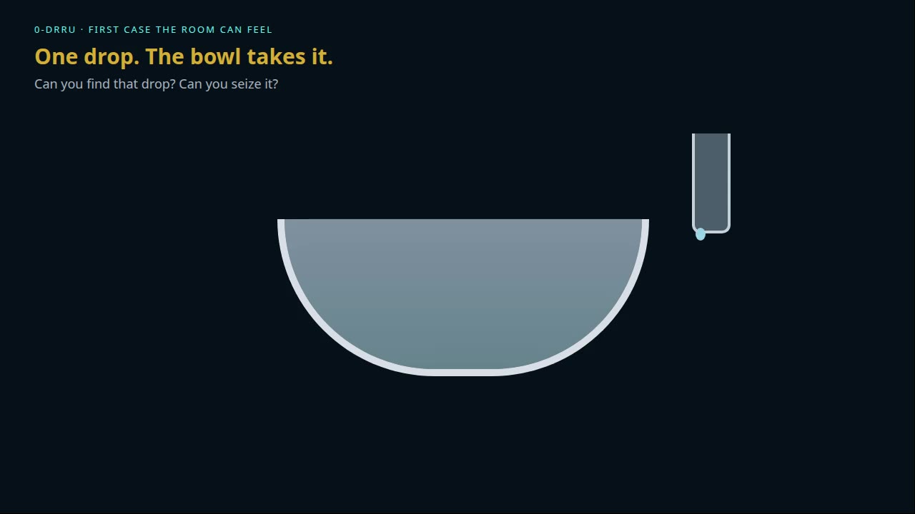
EMPTY GLASS
Can you find that drop? Can you seize it?
Working set lives briefly, then empties. Residual may be the tip only. A breach of our glass yields a hash.
SC-VAU · The Sidecar · One proof. Every door.
8 / 28

Slide 9
WHAT WE ARE NOT
Wallet, switch, app, and census are other sittings.
Not a stored-value house. Float stays on the licensed book, or we are not in the room.
Not a second settlement engine. Not a second reserve rail. Not a correspondent bank.
Not a store listing. Not a software-development kit harvest. Not a ringtone house.
Not a voter roll, a tax dump, a crew dossier, or a patient warehouse.
If you came for a purse, a download, or a parallel gateway — this is not that sitting.
SC-VAU · The Sidecar · One proof. Every door.
9 / 28

Slide 10
COMPANION · NOT A RIVAL
They move the value. We prove the event.
Any licensed settlement rail can keep the ledger — national switch, card, real-time gross, correspondent, treasury pipe.
We name their engine in the envelope. We do not clone their map. We do not sit inside their clock.
UPI, SWIFT, PAPSS, and every national switch are companions when a room already runs them. They are not our product.
If a room hears replacement, the sitting has failed.
SC-VAU · The Sidecar · One proof. Every door.
10 / 28

Slide 11
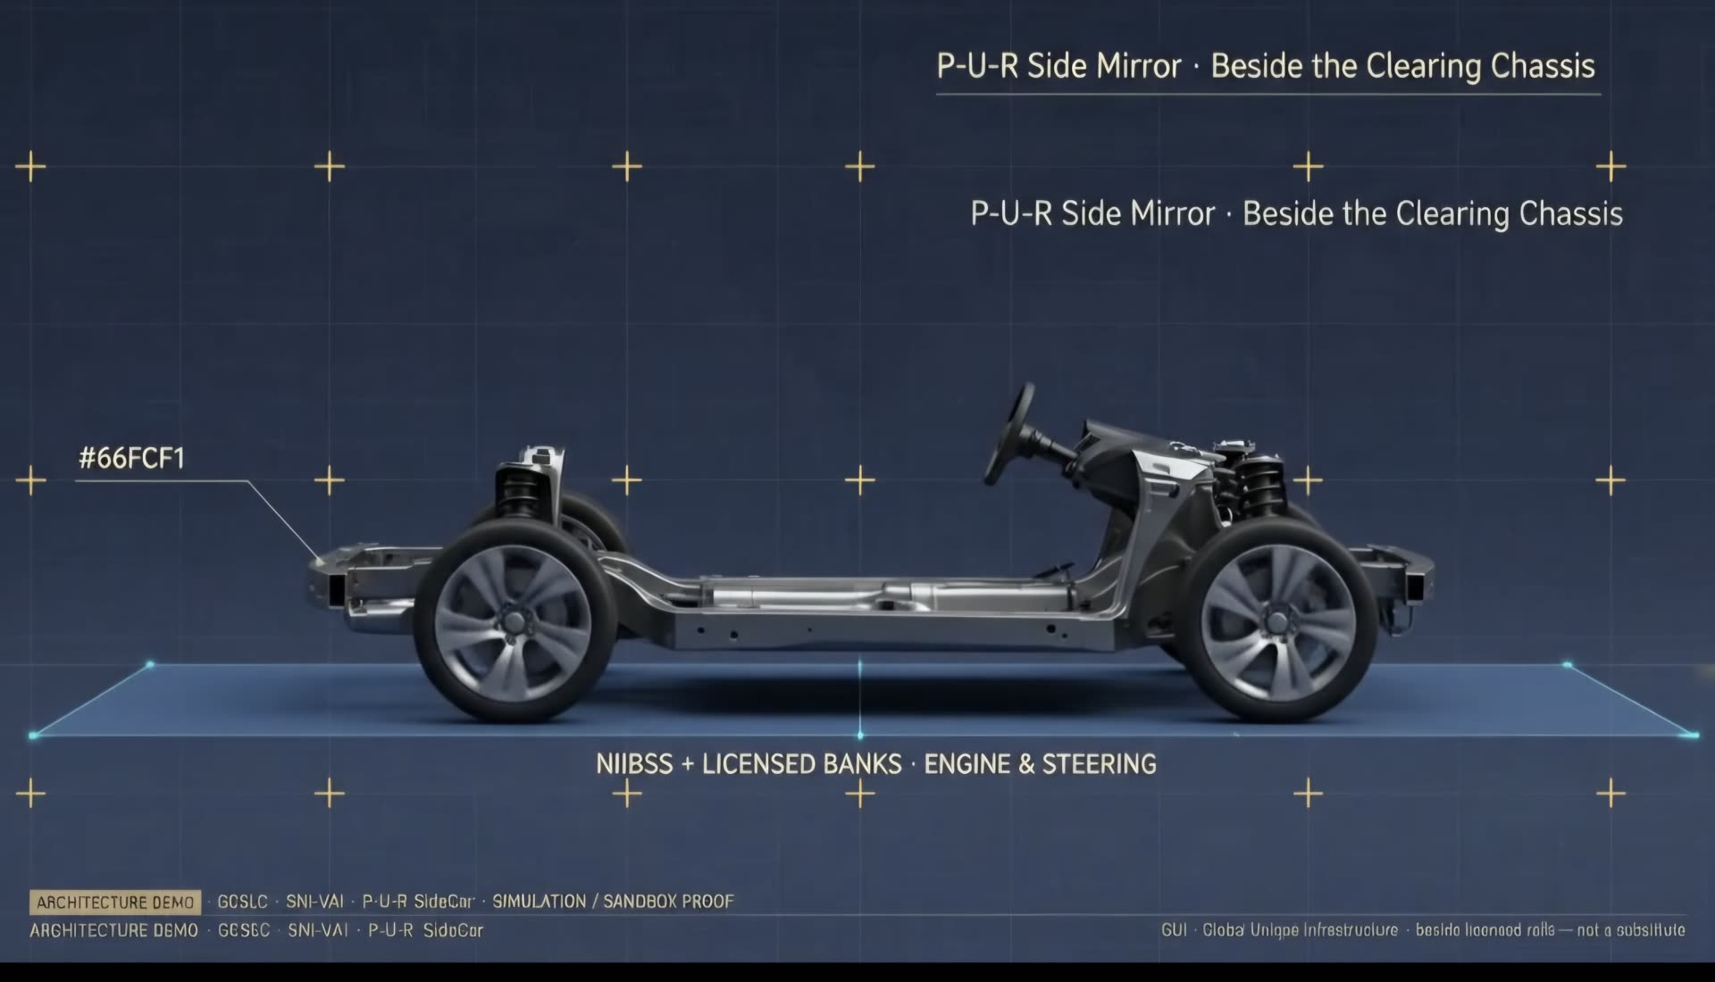
THEY STEER
Licensed rails are the engine. We are the mirror.
They hold the book and the float. We sit beside the chassis. We do not become the switch.
SC-VAU · The Sidecar · One proof. Every door.
11 / 28

Slide 12
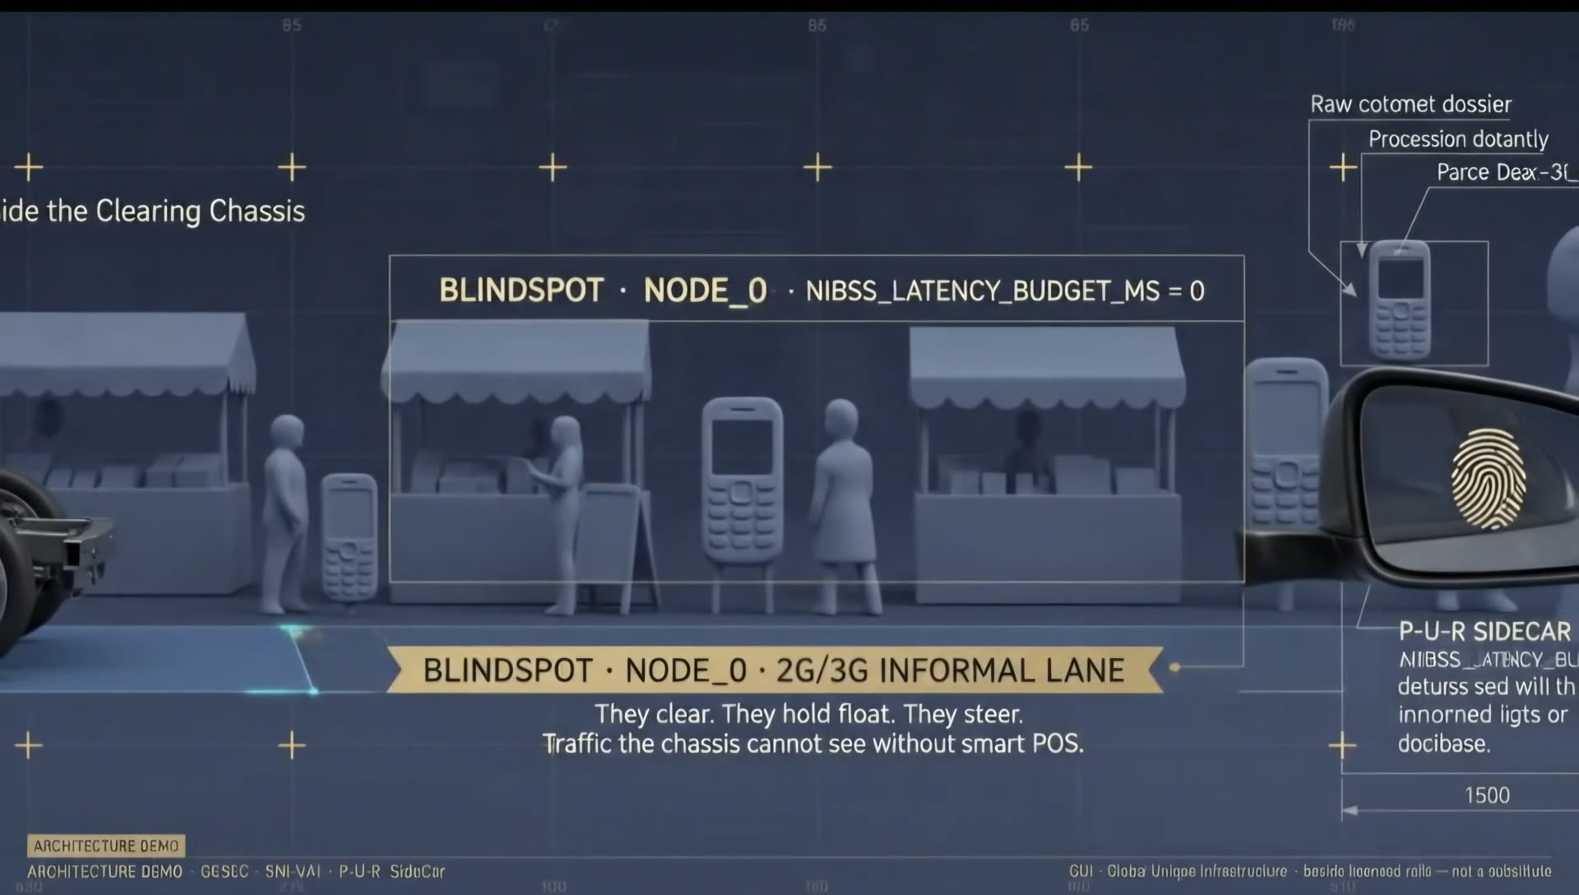
THE LAST MILE
The stall the chassis cannot see.
Work happens. Trust arrives late — or not at all. We illuminate the event. We do not take a face.
SC-VAU · The Sidecar · One proof. Every door.
12 / 28

Slide 13
THE MAJORITY
Yesterday’s phone is still today’s majority.
A basic phone is treated as a leftover. It is the present of most of the earth that still posts by hand and by radio.
Broadband and fifth-generation data are the future of a minority. They are not required for this stamp.
A smartphone is welcome. It is not the ticket of admission. You will not find SC-VAU in a download store.
Informal and formal use the same four fields. A stall and a high desk are one grammar.
SC-VAU · The Sidecar · One proof. Every door.
13 / 28

Slide 14
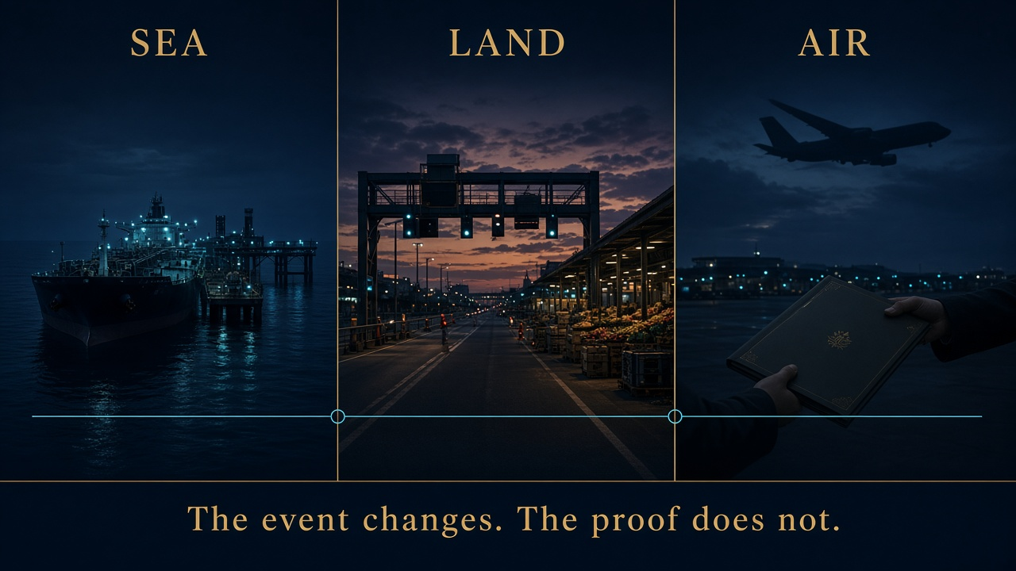
LAND · SEA · AIR
The event changes. The proof does not.
A till, a lift, a folio. Human tick or machine tick. Same four fields. Theatres, not a conquest map.
SC-VAU · The Sidecar · One proof. Every door.
14 / 28

Slide 15
HUMAN AND MACHINE
Same four fields. Same empty glass.
LAND · HUMAN
SEA · HUMAN
AIR · HUMAN
Till · gate
Crew handoff
Folio · hour
The majority already walks here.
Bill of lading. Not the vessel.
Slot and handoff.
LAND · MACHINE
SEA · MACHINE
AIR · MACHINE
Weighbridge
Berth tip
Runtime call
Same event-right. No model file.
Same four fields. No crew dossier.
Same flush. No prompt warehouse.
The payload is never a face and never a model. A clerk taps; a model calls the same utility. The prompt does not stay.
SC-VAU · The Sidecar · One proof. Every door.
15 / 28

Slide 16
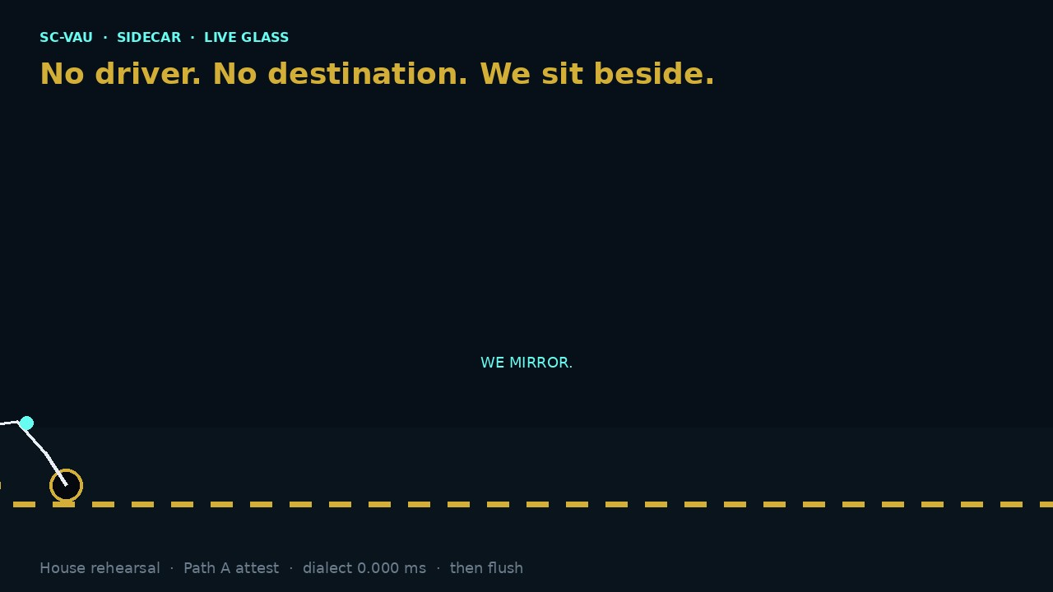
WATCH IT SIT BESIDE
No destination. The sidecar does not park.
Observe · mirror · illuminate · verify · attest · flush. Then empty glass. Not a god-eye.
SC-VAU · The Sidecar · One proof. Every door.
16 / 28

Slide 17
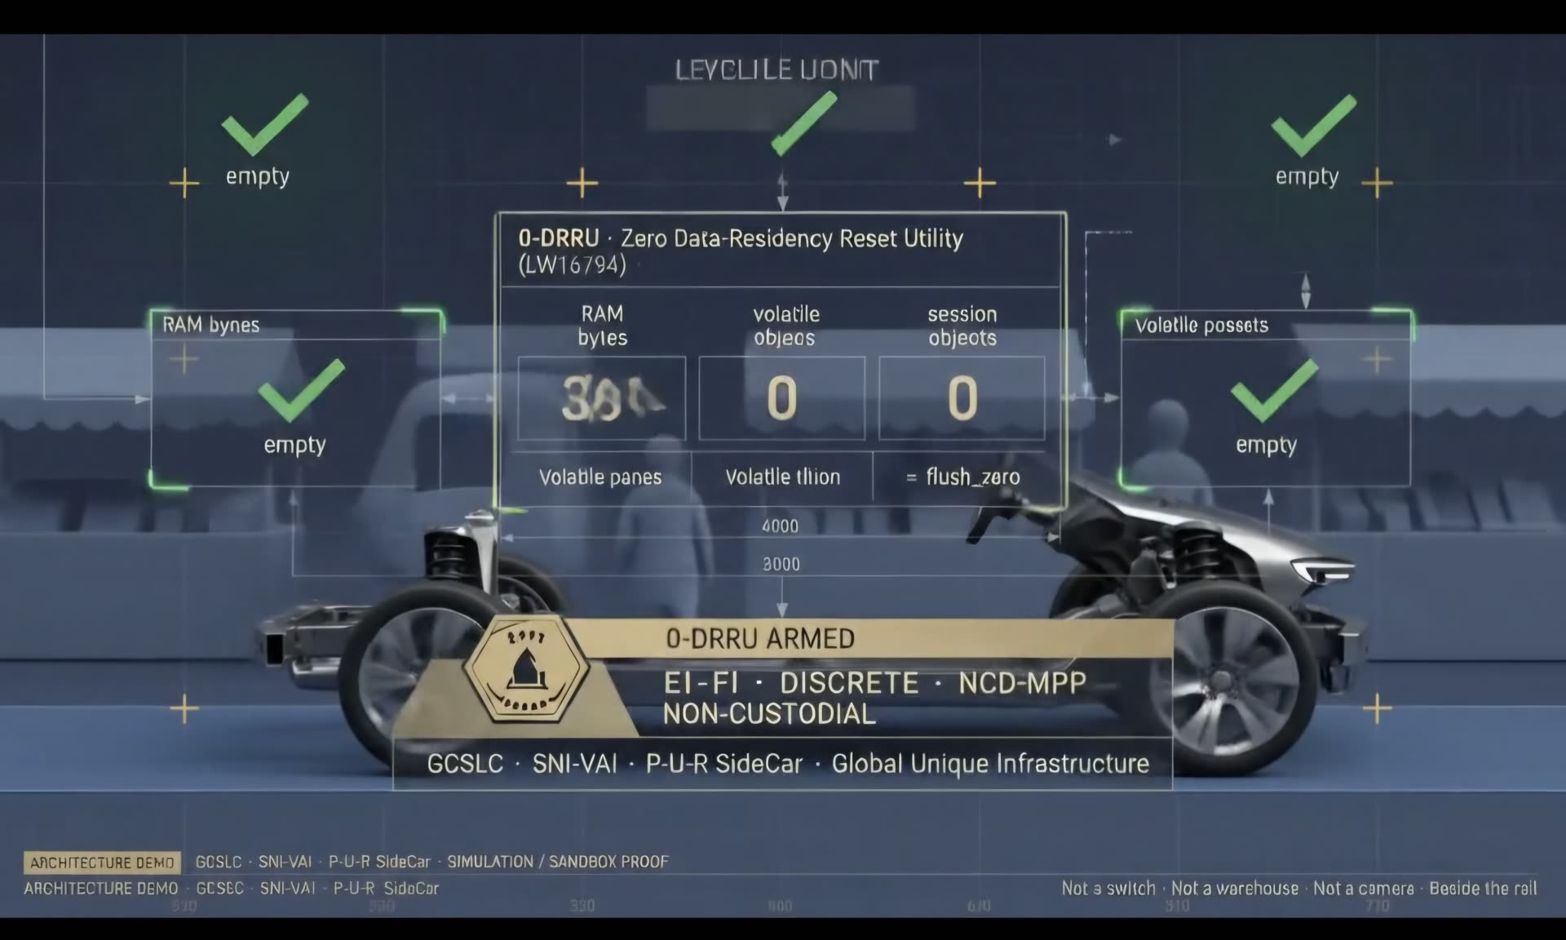
AFTER THE PROOF
Residency is zero.
Working memory emptied. A count of stamps may remain so one hundred means one hundred. The person is gone.
SC-VAU · The Sidecar · One proof. Every door.
17 / 28

Slide 18
HOW IT WORKS
Four breaths. No new religion.
1. Someone starts. Someone is meant to receive. That is ordinary life.
2. You do the real work on your licence — you post it on your book.
3. After you post — not before — we prove that this event happened. Fast. Local.
4. A short notice may follow on a phone they already hold. Then we empty our working glass.
It is proved, or it is not. There is no “maybe” on our side.
SC-VAU · The Sidecar · One proof. Every door.
18 / 28

Slide 19
THE LINE ITEM
Never a percent of the value. Never a charge on the citizen.
Where a sitting later agrees a stamp, it is operational expense after a successful post — a flat line, not a levy on the amount.
The citizen is not billed. The licensed book is not replaced. The settlement fee stays with the engine that earned it.
Failed post: no stamp. Same key: one stamp. A pile of pending stamps in one capital would be a second switch. We refuse that pile.
N desks are N glasses. Review the stamp — time, empty glass — then at a quarter. We do not publish a failure rate.
SC-VAU · The Sidecar · One proof. Every door.
19 / 28

Slide 20
A TREASURY · A CENTRAL BANK · A RESERVE
Who holds the money? They do.
We inherit their customer duty by sitting after their post. We do not open an account. We do not say crime-risk is zero.
We are not a second reserve, a second mint, or a parallel gateway into a sovereign vault.
Ghost paper without their commit: no stub. Photocopy, screenshot, reused clearance — refused.
The ask is a named desk and a time box — not a new licence to hold the public’s money.
SC-VAU · The Sidecar · One proof. Every door.
20 / 28

Slide 21
A BANK · A CLEARING HOUSE · A CARD RAIL
Your book remains the court.
You already posted. The last mile cannot see it. We show a short ticket from your own reference. Then we wipe.
We do not sit in front of your switch. If you have no successful post, we have no stamp.
Agents and clerks keep the ward when paper jams and screenshots lie. You keep the value and the fee.
You can kill us in one notify. That is how a banker sleeps.
SC-VAU · The Sidecar · One proof. Every door.
21 / 28

Slide 22
A GOVERNMENT · A PARTY · A CIVIC DESK
Proof is not a roll. A count is not a census.
A crossing, a grant, a result, a hall-right — an event. Never a roster of citizens, members, or communities.
Political and civic rooms may show a count without a people file. The person is gone after flush.
We do not become the election, the tax authority, or the ministry. They keep the licence.
Zero warehouse is not zero law. Your statute still sits. Our glass does not keep the names.
SC-VAU · The Sidecar · One proof. Every door.
22 / 28

Slide 23
A FIRM · A HOUSE · A CORRIDOR
Your kitchen. Our stamp. Their licence stays theirs.
Port, weighbridge, hangar, factory, hotel folio, batch release — they move the cargo. We prove the event.
Conglomerate or small stall: same four breaths. We do not become the works, the meter, or the fleet.
A mission pouch, a corridor, a lift — same overlay. We do not invent a flag for each country.
White-label if they want their mark on the ticket. The mathematics do not change.
SC-VAU · The Sidecar · One proof. Every door.
23 / 28

Slide 24
TECHNOLOGY CAPITAL
Zero retention that needs an iPhone is not the majority.
They discovered empty glass after the smartphone. We had to prove it on the phone that never left the stall.
We are not an endpoint, a model warehouse, or a software layer that steals the kitchen.
A prompt may call the same four fields. The prompt does not stay. The model is not the payload.
If the Valley came to file us as an app, the sitting has failed. File us as a sidecar, or do not file us.
SC-VAU · The Sidecar · One proof. Every door.
24 / 28

Slide 25
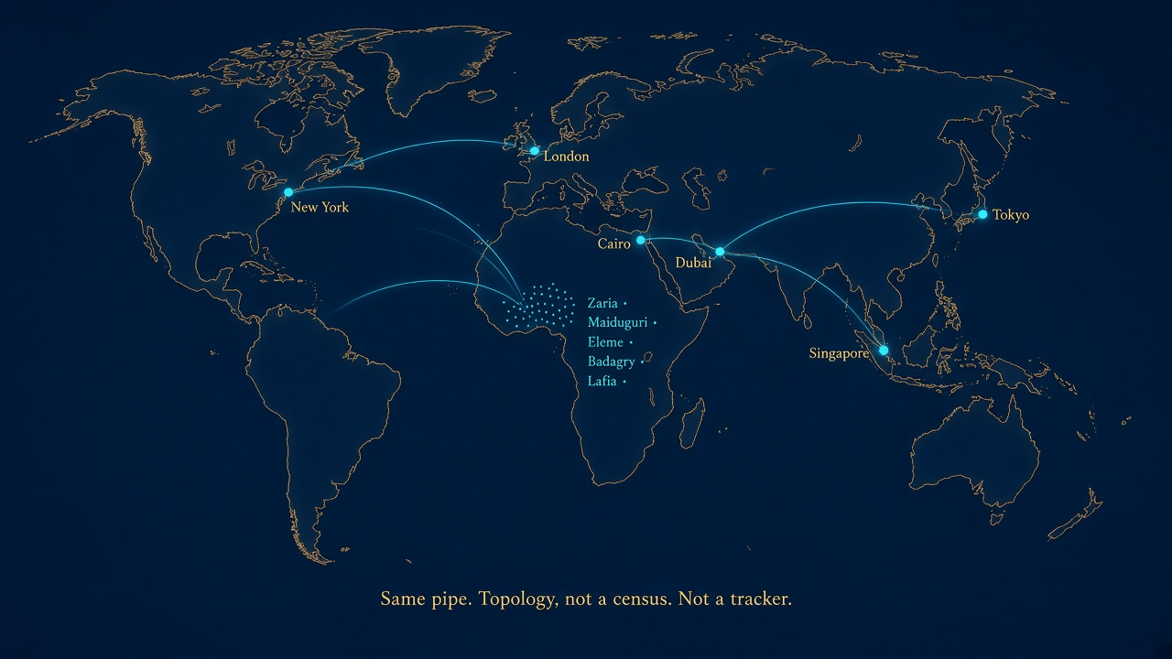
ONE PIPE
We do not invent a flag for each capital.
Topology, not a tracker. A stall and a high desk. Any door. Same contract. Offered to inspect.
SC-VAU · The Sidecar · One proof. Every door.
25 / 28

Slide 26
THE LATTICE
They stand together. None works alone.
Refine the tip. Reset the glass. Research the phone already in the hand. Restructure one overlay for stall and ministry.
Resuscitate idle signalling they abandoned. Revitalize the majority those apps walked past.
Re-engineer: beside the switch, never the switch. Retain: attest, then flush. Never harvest.
Miss one and the others collapse. You cannot resuscitate a lane while you retain a warehouse.
SC-VAU · The Sidecar · One proof. Every door.
26 / 28

Slide 27
WHAT WE ASK
Twenty minutes. One event. A named desk.
One event they already run. Not a public kiosk. Not a download.
A counterpart who can nod after a successful post, and stop the nod if they must.
First sitting, then a quarter — review the stamp, not a publication of their failure rate.
We do not ask to become their bank, their meter, their census, their flag, or their reserve.
SC-VAU · The Sidecar · One proof. Every door.
27 / 28

Slide 28
WHAT WE NEVER DO · GCSLC · ABUJA
Say this out loud. It keeps every room honest.
We do not hold your money, your oil, or your cargo. We are not a wallet, a switch, or an app.
We do not replace your meter, your bank, or your operators. We do not keep a file of citizens, crews, or communities.
We do not ask anyone to download an app to exist. We do not claim the notice cannot fail. Your book is the truth if it does.
We do not sell 12.3 ms as a wide-area clock, uptime, or a dark cell lit.
Dr. Jaafaru Sa’ad, Chairman
Galadiman Ruwa Center for Strategic Leadership and Communication
gcslc.research@gmail.com · +234 809 911 1515 · galadimanruwacenter.org · UNGM 1270319
SC-VAU · The Sidecar · One proof. Every door.
28 / 28

